Slide 1



CUSTOMER SHOPPING TRENDS
THE GEORGE WASHINGTON UNIVERSITY
INTRODUCTION TO DATA MINING)
Presented by: Sandhya Karki, Rakesh Venigalla, Qibin Huang

Slide 2


ABOUT THE DATASET
19
Comprehensive Details: Includes demographics (age, gender) and shopping habits (purchase history, payment methods, purchase frequency).
Consumer Insights: 3,900 records on shopping behaviors and demographics.
Learning Tool: Ideal for practicing data analysis skills.
Kaggle Access: Available for exploration on Kaggle's platform.
COLUMNS
3900
ROWS
TARGET VARIABLE:
Purchase Amount

Slide 3






REASON BEHIND THIS DATASET
Tailored to Retail Business Needs:
The dataset helps businesses understand what customers want, which is key to doing well in today's market.
Customization:
It shows what each shopper likes, helping stores make shopping feel special for everyone.
Data-Driven Decision Making:
By offering a clear picture of customer behavior, the dataset empowers businesses to make informed, data-driven strategies.
Experiment with AI-Generated Data:
Tested a Synthetic Dataset to evaluate its usefulness compared to actual data.

Slide 4

DATA
CLEANING

Slide 5
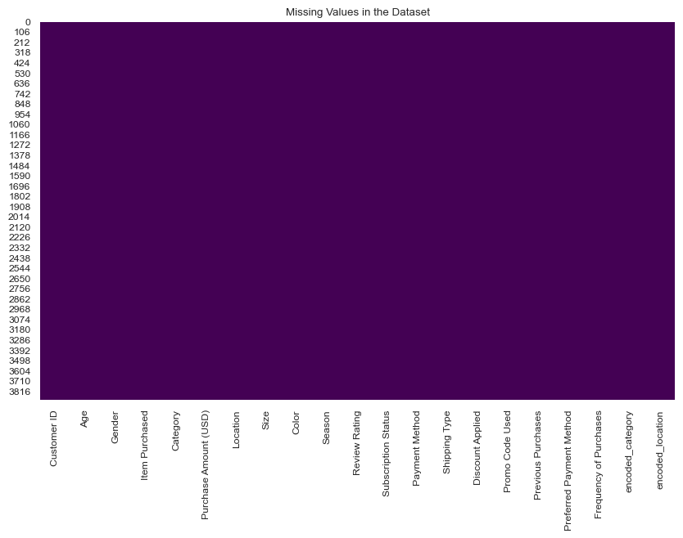
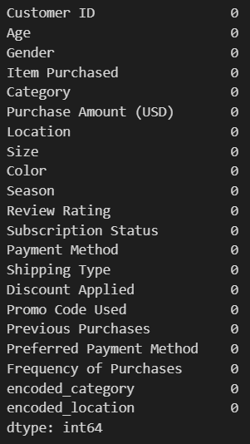
Null Values
Data Cleaning

Slide 6

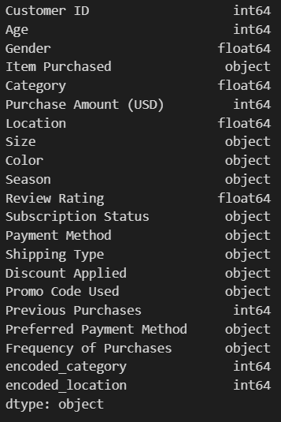


Considered Variables
Gender
Category
Location

Slide 7
EXPLORATORY
DATA ANALYSIS

Slide 8

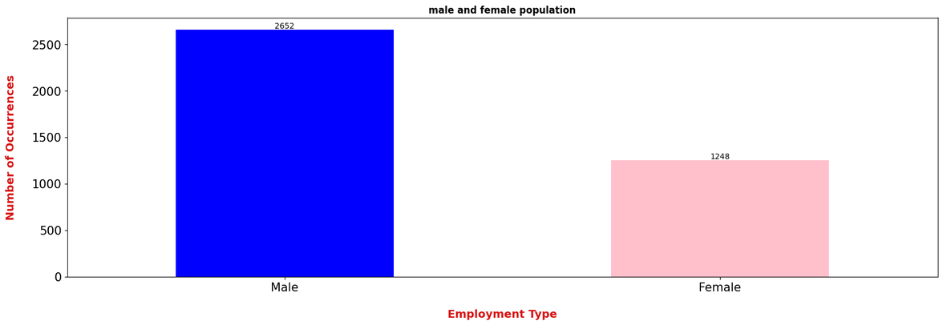
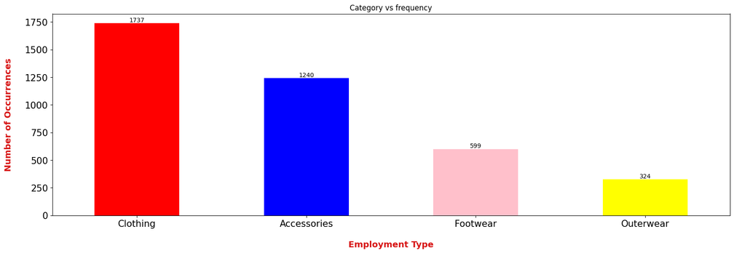
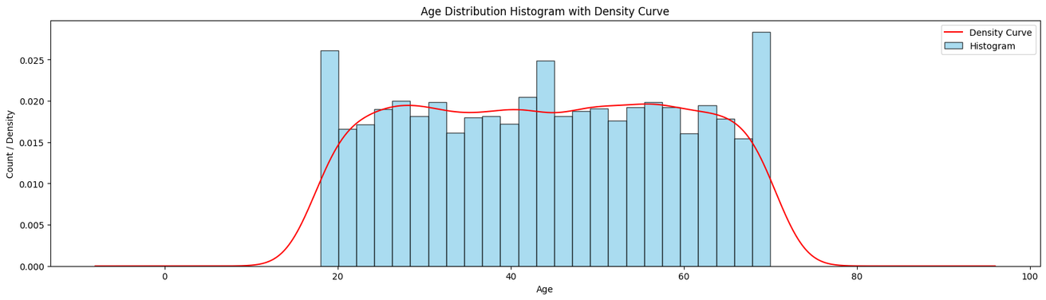
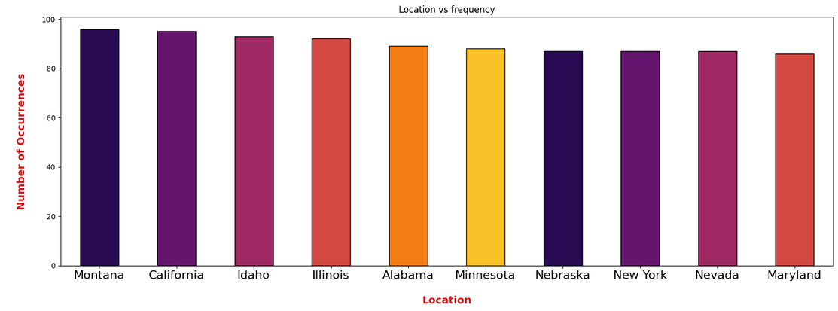
Data Visualizaion By Frecuency

Slide 9
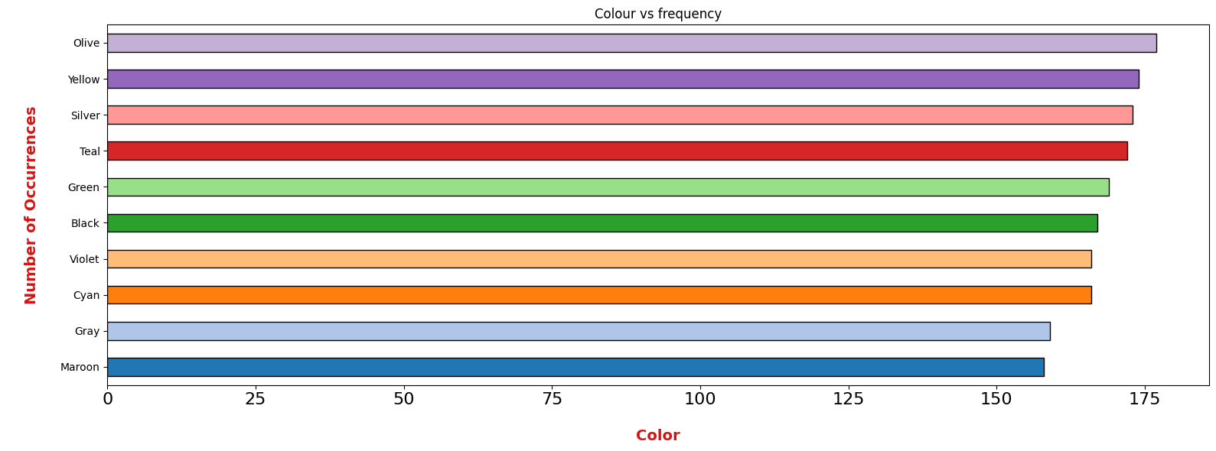
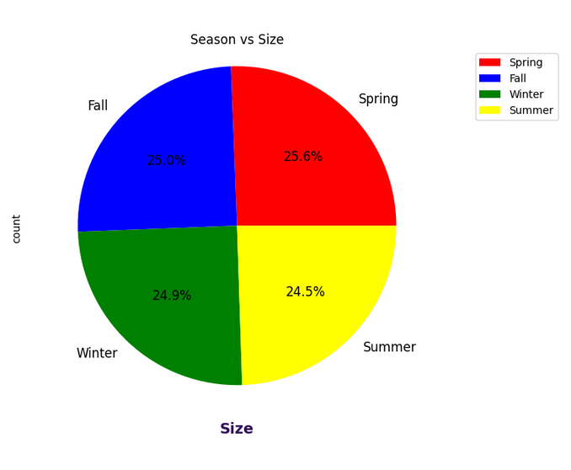
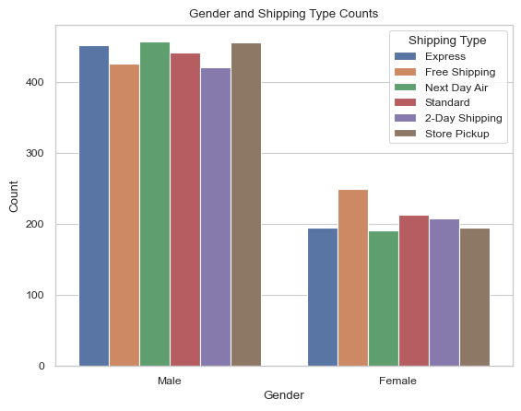
Data Visualizaion By Frecuency

Slide 10
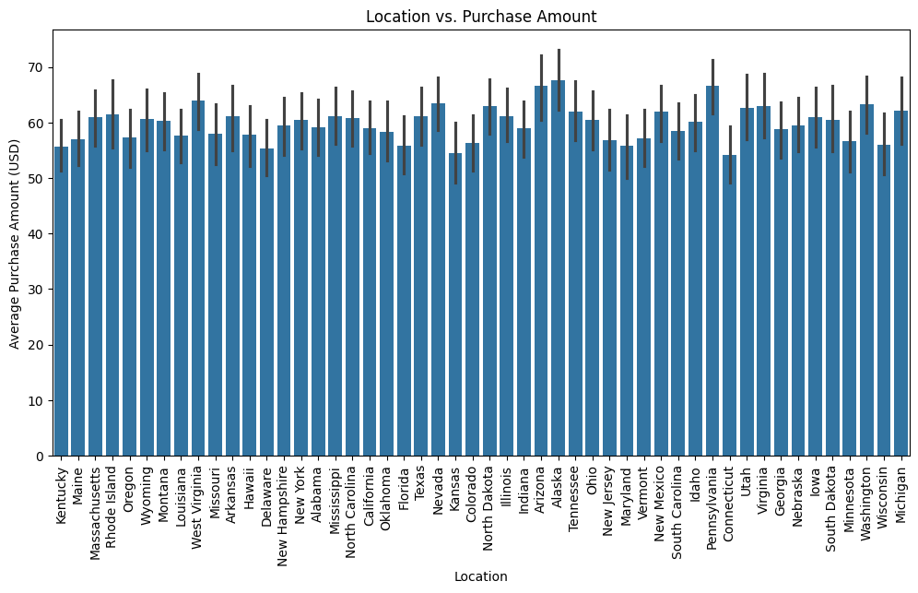
Visualiztion With - Target Variable

Slide 11
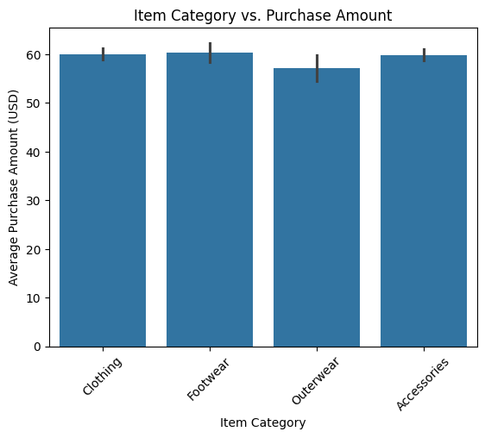
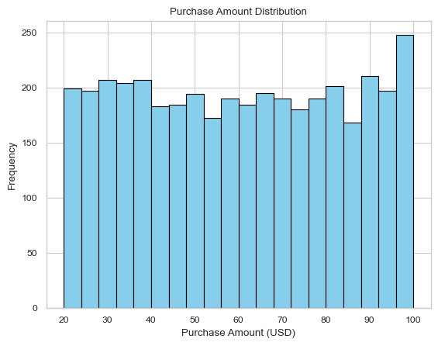
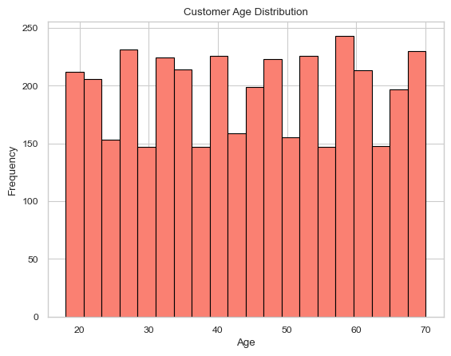
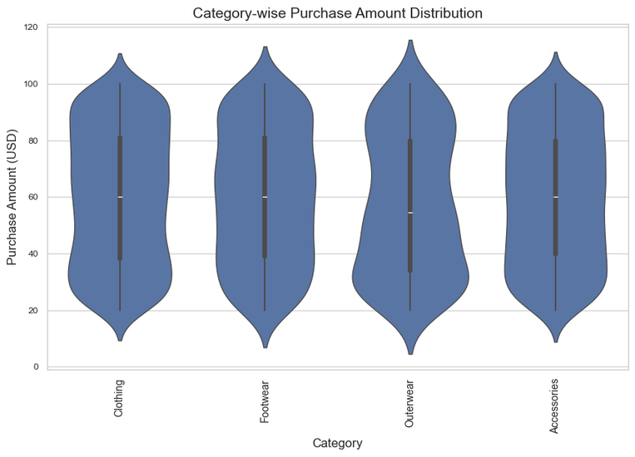

Slide 12


SMART
QUESTIONS

Slide 13

SMART QUESTIONS
1
2
3
Which factors (such as customer age, item category, location, etc) have the most significant impact on the purchase amount?
What is the relationship between review ratings and repeat purchases?
Correlation between the Purchase Amount & customer’s Repurchase Behavior and the Product Category
Objectives: Identify the key features that influence the purchase amount.
Using this analysis, we reveal if higher-rated products or services lead to more repeat purchases, indicating customer satisfaction.
how the amount spent on purchases is related to customer loyalty and the type of products they buy.

Slide 14


Smart Question - 1
Which factors (such as Gender, customer age, location) have the most significant impact on the purchase amount?
Objectives: Identify the key features that influence the purchase amount.

Slide 15
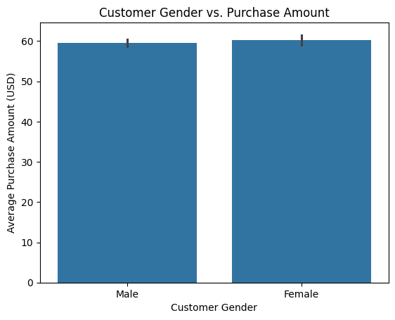


Slide 16
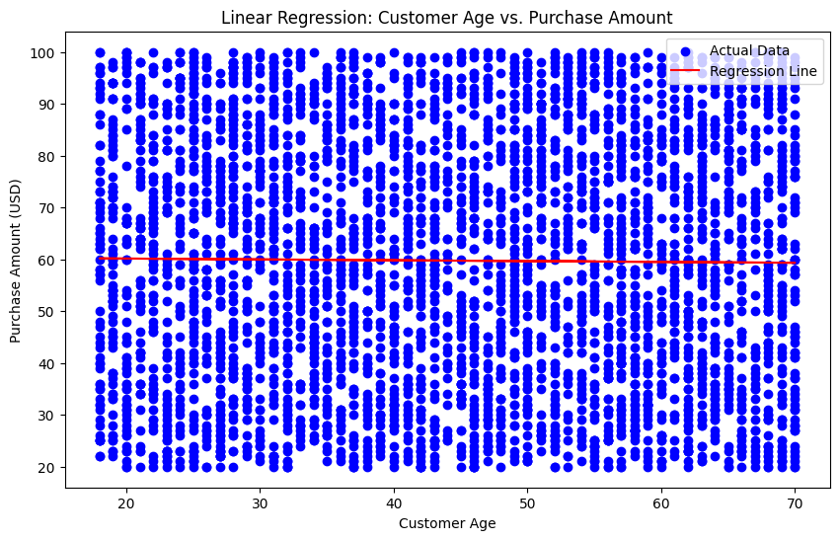
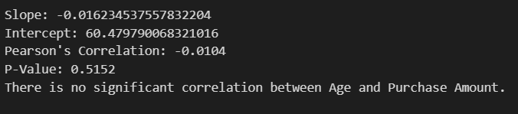

Slide 17
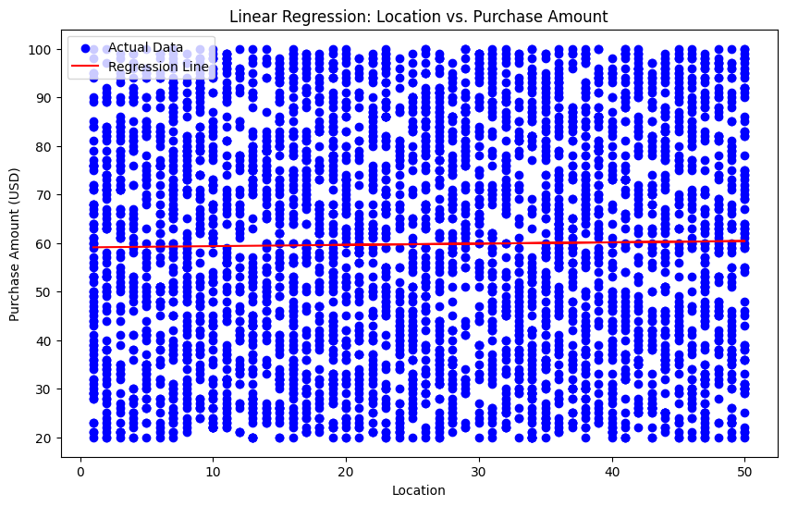
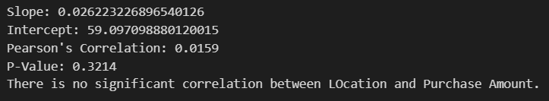

Slide 18
CONCLUSIONS
After a comprehensive analysis, it seems that Age, Gender, and Location don't greatly effect how much individuals spend on items. Even after going deep into the data, there's no apparent correlation between these criteria and the amount paid. This implies that other factors may have a greater impact on how much people decide to buy.

Slide 19
Smart Question - 2
What is the relationship between review ratings and repeat purchases?
Objectives:
Using this analysis, we reveal if higher-rated products or services lead to more repeat purchases, indicating customer satisfaction.We also analyze how negative reviews influence repeat purchases compared to positive reviews.

Slide 20
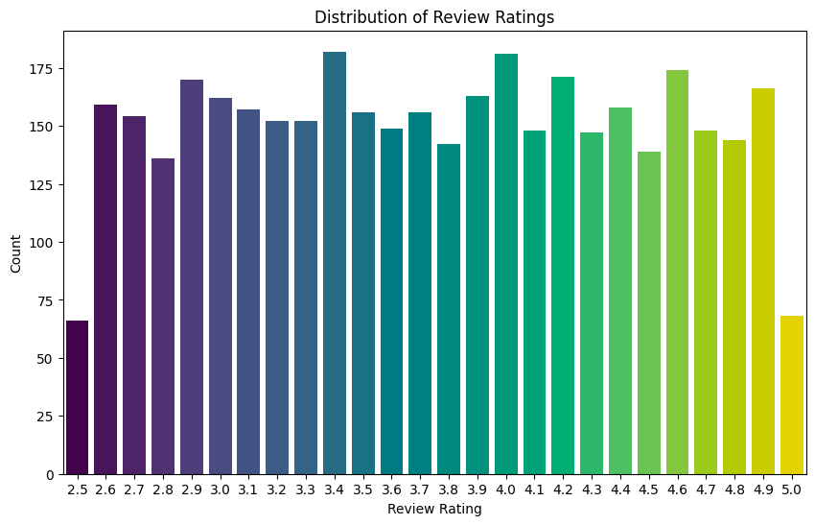
Exploratory data analysis
Uniform Rating Distribution:
The plot shows a well-mixed range of review ratings from 2.5 to 5.
Lowest Rating Observations:
The fewest product counts are linked to the ratings of 2.5 and 5.
As we can see from the plot, the distribution of review ratings is almost uniform. This means that our data has a good mix of review ratings from 2.5 to 5. The lowest groups among them (2.5 and 5) appear to have the fewest products associated.

Slide 21
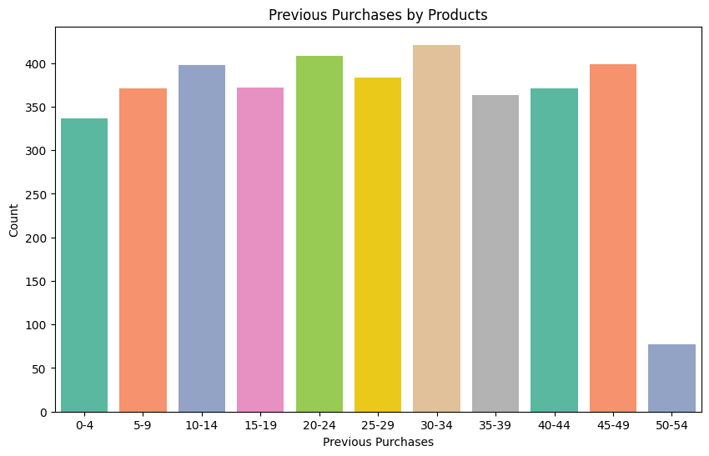


EDA of Frequency of Previous Purchases
Re-purchase Frequency: Indicates that products are re-purchased with similar frequency within the 0-49 times range.
** Only a small number of products are re-purchased more than 50 times.**

Slide 22
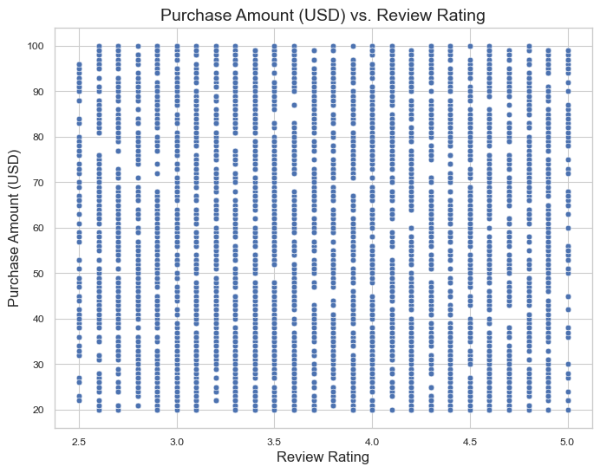
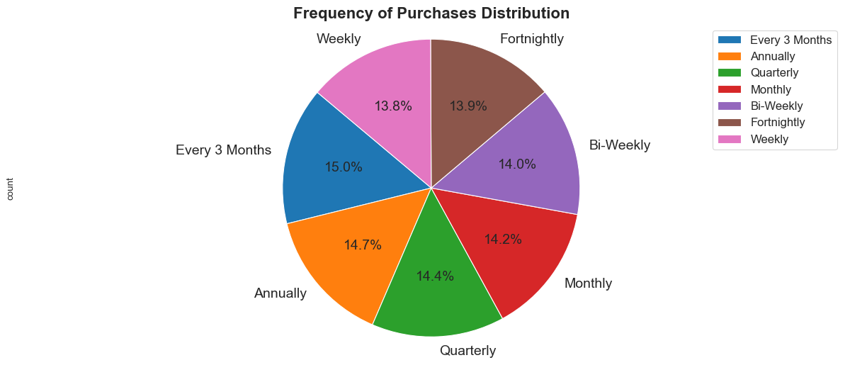
More Data Analysis
The plot suggests no correlation between X and Y, indicating they are independent.
The most common re-purchase rate is quarterly, with a diverse mix in other frequencies from the 3900 sales records.

Slide 23
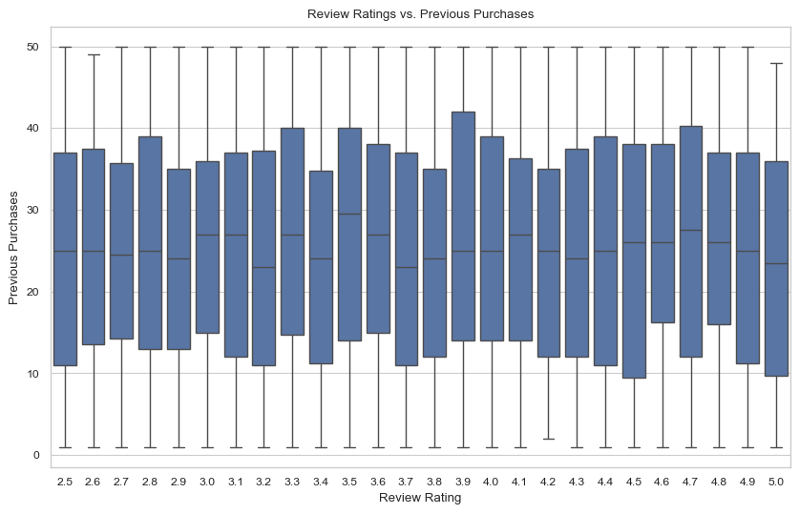
Boxplot for Review Ratings vs. Previous Purchases
**Contrary to our expectations, Data reveals higher ratings don't necessarily correlate with repeat purchases.**.
Products with “3.9” review rating show the highest previous purchases.
Notes:
Boxplot

Slide 24
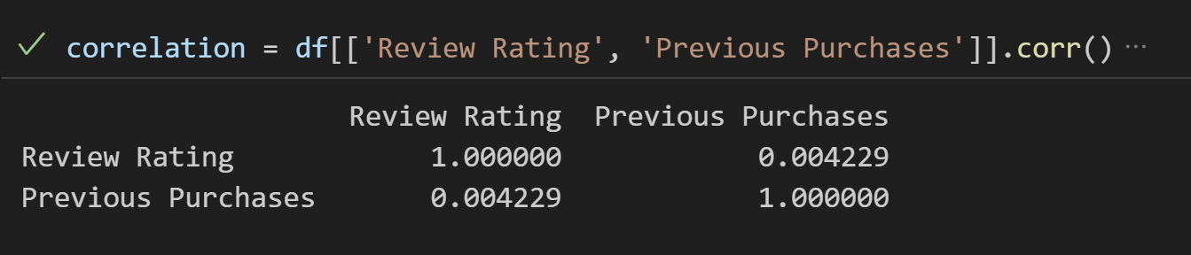
STATISTICAL TEST (CORRELATION MATRIX):
A correlation matrix is used to evaluate the linear relationship between 'Review Rating' and 'Previous Purchases'.
Since the correlation coefficient (0.004229) between 'Review Rating' and 'Previous Purchases' is close to 0, virtually no linear relationship.
No Linear Relationship: Review ratings don't linearly predict previous purchase numbers.

Slide 25
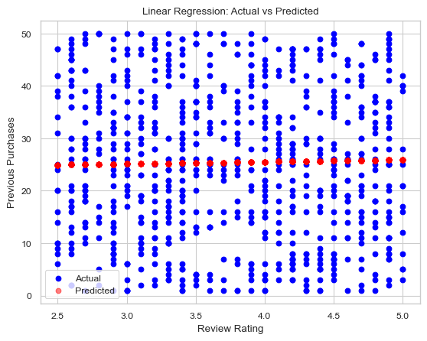
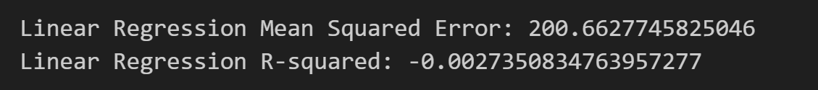
Linear Regression Model
Now we create a linear regression model to find the relation between the two.
High Mean Squared Error: model's poor performance in predicting purchases.
Weak Correlation Impact: Aligns with the minimal link between 'Review Rating' and 'Previous Purchases'.
Model Inadequacy: This suggests linear regression isn't suitable for the data's complexity.
Constant Prediction Trend: The linear model predicts a uniform purchase number across different review ratings, indicated by a flat line of red dots.

Slide 26
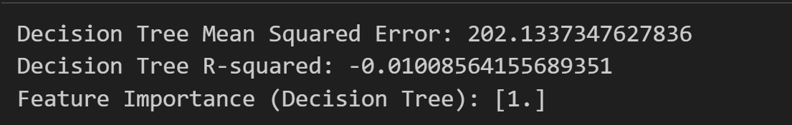
Decision Tree regressor.
Decision Tree MSE: Reported a Mean Squared Error of 202.
Comparable to Linear Model: MSE is simialr to the Linear Regression's results.
Limited Improvement: No notable enhancement in predicting purchases from review ratings.

Slide 27
CONCLUSIONS
The analysis of both models suggests a weak relationship between 'Review Rating' and 'Previous Purchases', as indicated by the high MSEs and low R-squared values.
Despite using advanced models, the predictive accuracy was low.
This challenges usual assumptions, highlighting differences between synthetic and real-world data. It emphasizes the need for real-world data to gain accurate, practical insights.

Slide 28
Smart Question - 3
Correlation between the Purchase Amount & and customer’s Repurchase Behavior and the Product Category
Objectives:
Customer Retention
Product Targeting
Marketing Strategy
Revenue optimization

Slide 29
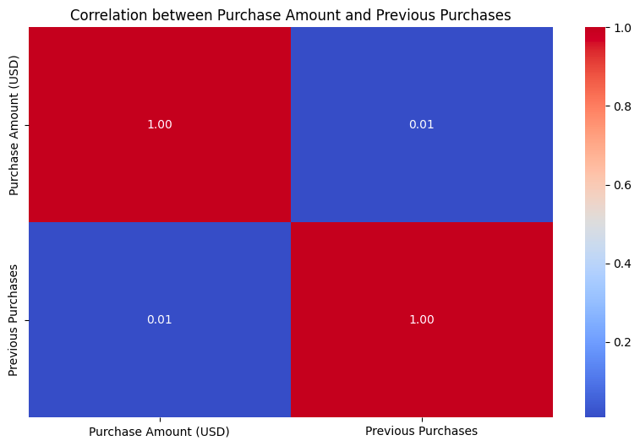
Correlation analysis between 'Purchase Amount (USD)' and 'Previous Purchases'
The correlation coefficient = 0.01
No significant linear relationship between the two variables
The frequency of a customer's previous
purchases do not linearly correlate with their spending amount.

Slide 30

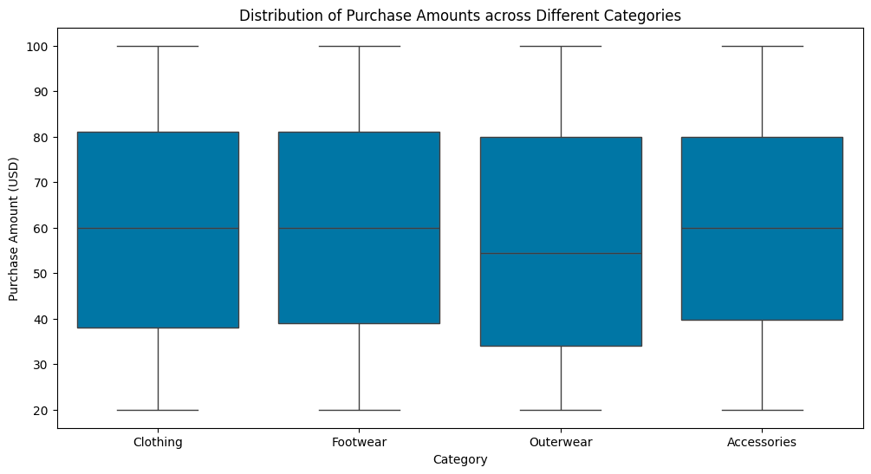
Grouping data by 'Category' and analyzing the distribution of 'Purchase Amount (USD)'
Average spending amounts (mean and median) are consistent across categories.
Product category may not significantly influence spending.

Slide 31

The Regression Model between the
predicted and actual purchase amounts
MSE
R2

Slide 32
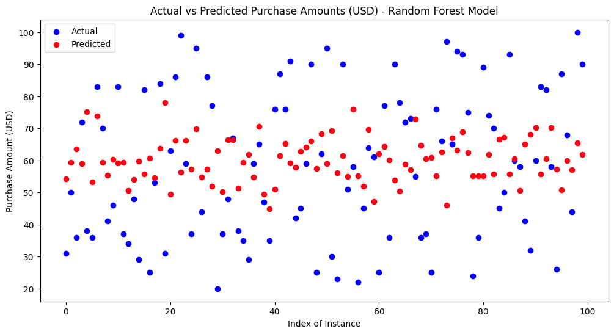
Actual vs predicted values in Random Forest model
the poor model fit is indicated by the negative R² value
the need for model adjustments or exploring different predictive approaches.
a mismatch between the actual purchase amounts (blue points) and the model's predictions (red points)

Slide 33
Cleaning the outlier
Calculating IQR
Found boundaries of these variables
Cleaning it
Calculate it again
This implies the weak correlation observed is not influenced by outliers
It suggests that purchase amount does not significantly affect repeat purchases in this dataset.

Slide 34
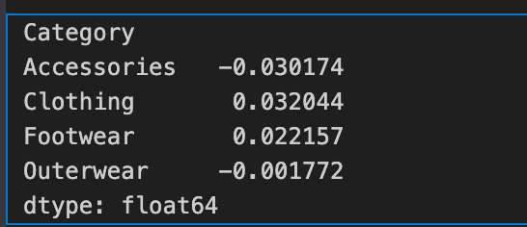
Group data by category
Reinforces previous findings: Purchase amount does not significantly influence repurchase behavior across the dataset as a whole.
The inclusion of product categories does not seem to change this conclusion significantly.

Slide 35
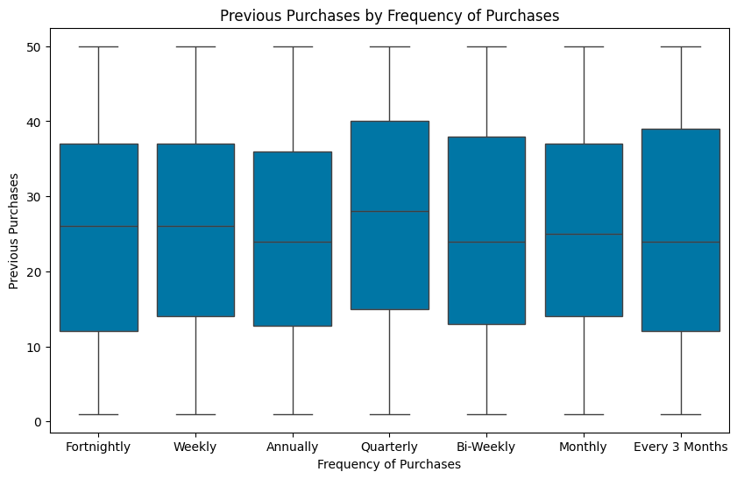
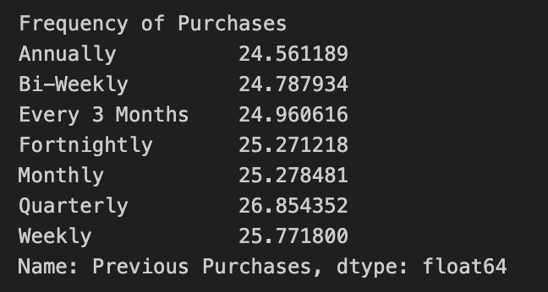

Previous Purchases VS Frequency of Purchases
Method 1: Descriptive statistical analysis
Method 2: Visual analysis
Method 3: Chi-squared Test

Slide 36
Previous Purchases VS Frequency of Purchases
Conclusion: no significant statistical relationship!
So what does this suggest to our question? Did we expect this?

Slide 37
LIMITATIONS
REVIEW RATINGS' SUBJECTIVITY
CONSUMER INSIGHTS USING SYNTHETIC DATA
LIMITED DEMOGRAPHIC DATA
NO INFORMATION ON PROMOTIONAL ACTIVITIES
LACK OF REAL-WORLD
Data Authenticity
VARIABLES ARE ﻿INDEPENDENT

Slide 38



CONCLUSIONS
Conclusion 1
Conclusion 2
Conclusion 3
Weak Correlation Between Review Ratings and Previous Purchases
Ineffectiveness of Linear Regression Model
Weak Correlation Between Purchase Amount and Repurchase Behavior
Limitations of the Dataset
Use real-life data,
Use different models/statistical tests
data cleaning
We will work on the limitaiton of dataset

Slide 39
CONCLUSIONS
Seasonal Influence on Purchase Behavior
Impact of Demographics on Purchasing Habits
Channel Preferences for Purchase
Product Category Preferences
Customer Engagement and Repurchase Behavior

Slide 40

QUESTIONS/CONCERNS/COMMENTS?
QUESTIONS/CONCERNS/COMMENTS?

